Slide 1

Bright-Tv is South Africa’s go-to digital platform for live sports, music, series, and local entertainment—all in one place. Whether you're watching on your phone or TV, Brigh-tTV brings the content you love, whenever and wherever you want it.
Presented By : RIBA MAUBANE (C.E.O)

Slide 2
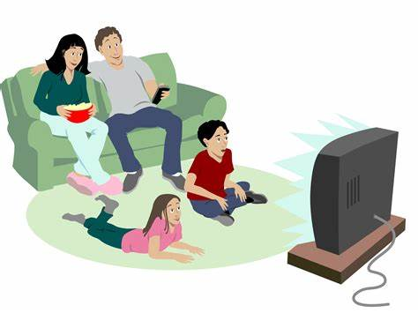
USERS AND TRENDZ
Total Count of USERID
10000

Slide 3
TOP VIEWED CHANNELS
CHANNELS | COUNT
Africa Magic | 859
Boomerang | 714
Break in transmission | 66
Cartoon Network | 793
Channel O | 1050
CNN | 505
DStv Events 1 | 107
E! Entertainment | 367
ICC Cricket World Cup 2011 | 1465
kykNET | 45
Live on SuperSport | 2
MK | 32
M-Net | 116
SawSee | 255
SuperSport Blitz | 896
Supersport Live Events | 1662
Trace TV | 952
Vuzu | 111
Wimbledon | 3

Slide 4
COUNT OF GENDER PER CHANNEL
CHANNELS | FEMALE | MALE | GRAND TOTAL
Africa Magic | 40 | 351 | 391
Boomerang | 56 | 263 | 319
Break in transmission | 4 | 26 | 30
Cartoon Network | 40 | 323 | 363
Channel O | 65 | 467 | 532
CNN | 30 | 186 | 216
DStv Events 1 | 7 | 43 | 50
E! Entertainment | 11 | 131 | 142
ICC Cricket World Cup 2011 | 72 | 557 | 629
kykNET | 3 | 21 | 24
Live on SuperSport | 1 | 1 | 2
MK | 2 | 13 | 15
M-Net | 5 | 48 | 53
SawSee | 13 | 112 | 125
SuperSport Blitz | 51 | 344 | 395
Supersport Live Events | 80 | 591 | 671
Trace TV | 46 | 393 | 439
Vuzu | 11 | 48 | 59

Slide 5
COUNT OF RACE BY PROVINCE
RACE | EASTERN CAPE | FREE STATE | GAUTENG | KWAZULU NATAL | LIMPOPO | MPUMALANGA | NORTH WEST | NORTHERN CAPE | WESTERN CAPE | GRAND TOTAL
BLACK | 105 | 68 | 776 | 206 | 158 | 253 | 100 | 34 | 111 | 1811
COLOURED | 69 | 14 | 93 | 29 | 8 | 17 | 4 | 28 | 417 | 679
INDIAN_ASIAN | 31 | 15 | 321 | 149 | 152 | 47 | 13 | 4 | 35 | 767
WHITE | 57 | 40 | 352 | 54 | 30 | 72 | 36 | 15 | 104 | 760

Slide 6
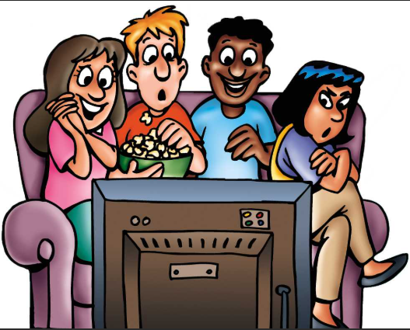
SUMMARY COUNT OF RACE BY PROVINCE
Gauteng is the most dominant province across all races, especially for Black and Indian-Asian users.
Western Cape is the leading province for Colored users.
White users are more evenly distributed across provinces.
The racial group with the highest number of users is Black.

Slide 7
TOTAL COUNT OF GENDER PER USER ID
GENDER | Count of USERID
female | 967
male | 8726
Grand Total | 9693

Slide 8
VIEWING TREND BY AGE GROUP
AGE DIFFERENCE | SUM OF COUNT
1-13 YRS - KIDS | 1000
14-20 YRS - TEENAGER | 1500
21-36 YRS - YOUTH | 2000
37-40 YRS – ADULT | 2500
50-60 YRS – MATURE ADULT | 3000
65-70 YRS - RETIRED | 3500

Slide 9
TYPES OF FACTORS INFLUENCING CONSUMPTION
REGION (PROVINCE)
Insight: Gauteng dominates with the highest number of users followed by Western Cape and KwaZulu Natal.
Interpretation: These regions are more urbanized, have better internet access, and likely higher digital literacy, directly boosting content consumptions.
2. RACE DEMOGRAPHICS
Insight: Black users represents the largest viewers group.
Interpretation: Tailoring content(e.g., Africa Magic) towards the majority demographic can boost viewership, as seen with its strong performance.
3.TIME & DAY
Insight: Viewership typically peaks after 6 PM and on weekends.
Interpretation: Users consume more when they’re of work or school. Scheduling high-value or live content during these hours can optimize engagement.
CONTENT TO RECOMMEND TO INCREASE COMSUMPTION ON THE DAYS WITH LOW CONSUMPTION
1. MIDWEEK SPORTS HIGHLIGHTS AND ANALYSIS
Why: Live sports dominate your top channels (e.g., Super-sport Live Events, ICC Cricket World Cup)
Idea: Offer match replay, analysis shows, “Top 10” moments, or mini-documentaries midweek to maintain engagement.
2. MUSIC AND ENTERTAINMENT DROPS
Why: Channels like Channel O and Trace TV show strong viewership.
Idea: Release exclusive music video premiers, celebrity interviews, or behind the scenes features.
3. READY DRAMA RELEASES
Why: Drama and entertainment build emotional connections that drive return viewership.
Idea: Drop 2-3 episodes of a new drama series midweek to hook viewers into returning by the week

Slide 10

WHAT TYPE OF INITIATIVE WOULD YOU RECOMMEND TO FURTHER GROW BRIGHT-TV’S USER BASE
HYPER-LOCAL CONTENT EXPANSION
Commission or license content in local languages (e.g., Zulu, Sotho, Xhosa).
Promote region specific stories, dramas, and community-driven shows.
2. STRATEGIC PARTNERSHIPS AND BUNDLING
Partnership expands reach into untapped markets (advertising).
Bundle Bright-Tv with telecom/internet providers at a discounted rate.
Collaborate with schools or universities for educational content access
3. CONTENT SCHEDULING BASED ON VIEWER PATTERN
Why: Evening and weekend viewership is highest.
Schedule new releases and promos in high-traffic time slots.
Promotes weekend binge-worthy content ahead of time with push notifications.

